Slide 1





Parallel Algorithm For Updating
SSSP In Dynamic
Networks
Notes:
Dynamic Networks
Real-world systems are often modeled as dynamic networks.
Network Analysis
Analysis uncovers key insights from structural properties.
SSSP Problem
SSSP is fundamental in network analysis, but existing algorithms work only on static graphs.

Slide 2

Introduction to the Problem
Many real-world systems are dynamic networks (e.g., social, traffic, cyber systems).
Single Source Shortest Path (SSSP) is a key operation in graph analysis.
Traditional algorithms assume static networks → inefficient for dynamic changes.

Slide 3


Why Static Algorithms Fail
Dijkstra's and Bellman-Ford recompute from scratch.
Poor scalability and performance for large networks.
Cannot handle frequent updates efficiently.
Notes:
Slide 4: Overview of the Research Paper
Title: A Parallel Algorithm Template for Updating SSSP in Large-Scale Dynamic Networks
Authors: Arindam Khanda, Sriram Srinivasan, Sanjukta Bhowmick, Boyana Norris, Sajal K. Das
Published In: IEEE Transactions on Parallel and Distributed Systems, 2022
Objective: Update SSSP efficiently in dynamic networks using parallel algorithms.

Slide 4

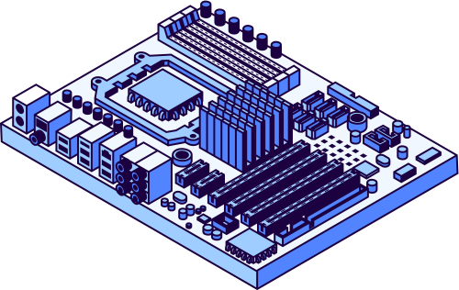
Key Contributions
Unified parallel framework for CPU and GPU.
Rooted Tree Data Structure for synchronization and load balancing.
Efficient batch processing for up to 100M changes.
Vertex-Marking Functional Blocks (VMFB) on GPU.
Achieved up to 8.5x GPU and 5x CPU speedups over existing methods.

Slide 5
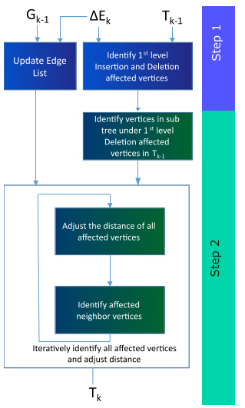
Parallel Framework Overview
Identify Affected Subgraphs
Determine the network portions impacted by changes.
Update Subgraphs
Update only the identified subgraphs efficiently.
Iterative Method
Minimize synchronization overhead for faster convergence.

Slide 6


Proposed Parallelization Strategy
Inter-node: MPI for distributed memory parallelism.
Intra-node: OpenMP (for CPU) or OpenCL (for GPU).
Graph Partitioning: METIS used to split graph for MPI processes.
Designed for scalability and cross-platform compatibility.

Slide 7


Role of METIS in Graph Partitioning
METIS divides the graph into balanced subgraphs.
Reduces communication overhead among MPI processes.
Ensures minimal edge cuts and local processing efficiency.
Enables parallel execution with reduced synchronization.

Slide 8
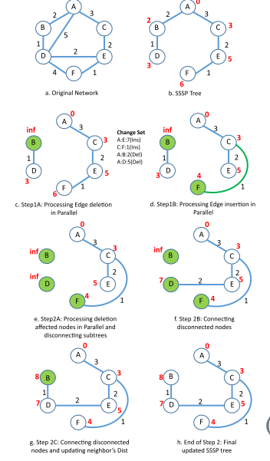
Algorithm Steps
Step 1: Identify affected vertices using parallel edge processing.
Step 2: Update affected subgraphs iteratively.
Avoid cycles and ensure shortest paths using rooted tree.

Slide 9

Addressing Scalability Challenges
Load Balancing
Dynamic scheduling balances workload across processing units.
Synchronization:
Iterative updates minimize synchronization needs.
Cycle Avoidance
Processes subtrees of deletion to mark distances to infinity.

Slide 10
Implementation Details
Shared-Memory
Uses OpenMP for parallel processing.
Processes insertions and deletions in parallel.
GPU
Employs CUDA threads and Vertex-Marking Functional Blocks (VMFB).
Leverages SIMT execution for data-parallelism.

Slide 11
Implementation Platforms
Shared Memory: OpenMP-based CPU parallelism.
GPU Acceleration: OpenCL/CUDA with VMFB blocks.
Distributed System: MPI for node-level parallelism.
Supports asynchronous and batch processing.

Slide 12
Experimental Evaluation
Datasets
Employs real-world and synthetic networks.
Metrics
Focuses on execution time over TEPS.
Comparison
Compared against Galois (CPU) and Gunrock (GPU).

Slide 13
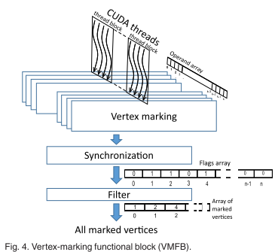
GPU: Vertex-Marking Functional Block (VMFB)
Marks affected vertices efficiently in parallel.
Uses limited synchronization and atomic operations.
Key to GPU scalability and correctness

Slide 14
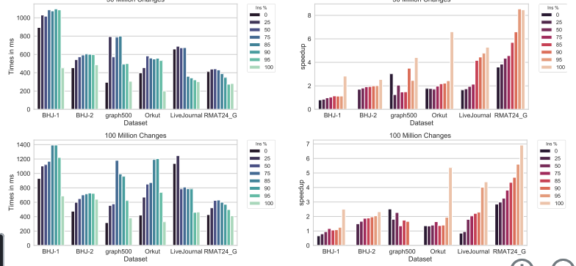
Performance Results
Up to 8.5x speedup on GPU (compared to Gunrock).
Up to 5x speedup on CPU (compared to Galois).
Works efficiently on both real-world and synthetic datase

Slide 15
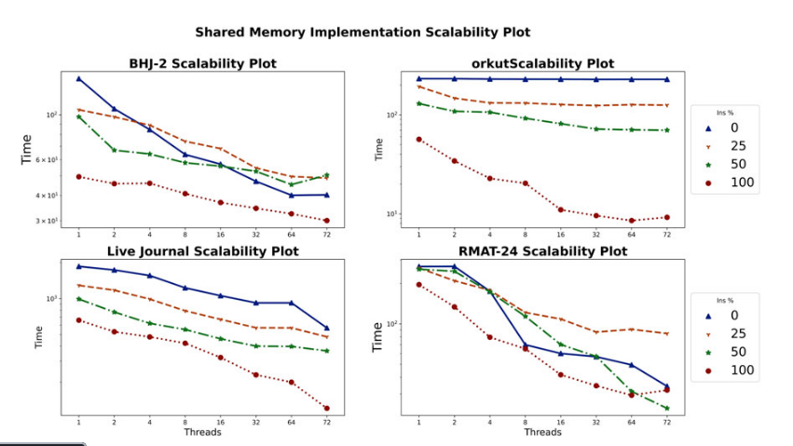
Scalability Analysis
Performance improves with increasing threads (OpenMP).
Efficiency drops slightly after high deletion rates (>75%).
Batch processing and load balancing critical for scale.

Slide 16
Conclusion & Future Work
Proposed a scalable parallel framework for dynamic SSSP.
Demonstrated strong performance and cross-platform adaptability.
Next Phase: Implement algorithm using MPI + OpenMP/OpenCL
Evaluate real dataset performance, visualize results

Slide 17
References
A. Khanda et al., "A Parallel Algorithm Template for Updating SSSP...," IEEE TPDS, 2022.
PDC Project Document
METIS Library Documentation
MPI, OpenMP, OpenCL official guides

